Slide 1
Webly Supervised Training of Convolutional Networks
Xinlei Chen, Abhinav Gupta
Carnegie Mellon University

Slide 2
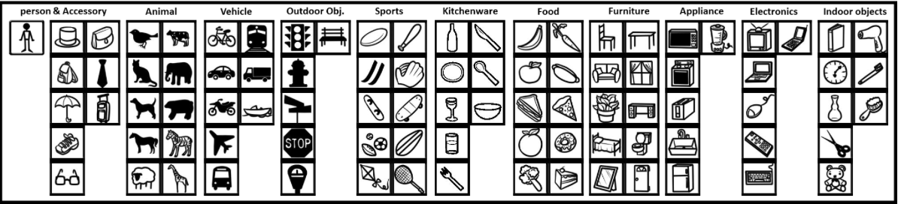
Object Detection
PASCAL VOC
MS COCO
>35% mAP for ~80 categories!
[Felzenszwalb et al., TPAMI’10] [Girshick et al., TPAMI’15] [Girshick, ICCV’15]
Notes:
over the last 2-3 years, the state of the art of object detection has improved significantly. for example, the deep network based RCNN has doubled the performance on pascal voc
and even on the more challenging and one of the biggest dataset of microsoft coco, where there are lots of smaller objects, a similar R-CNN approach can give a mAP of> 36%.

Slide 3
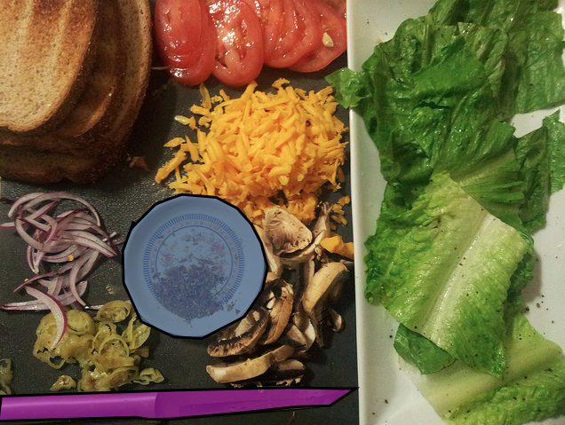
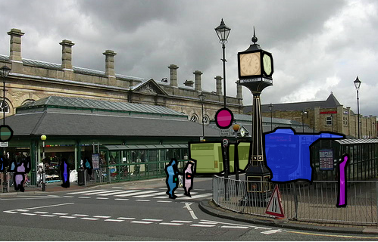
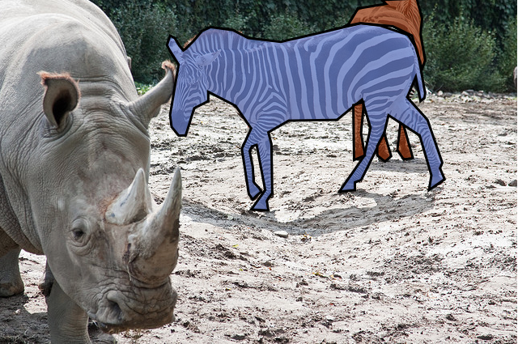

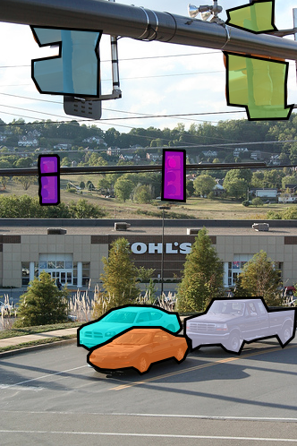
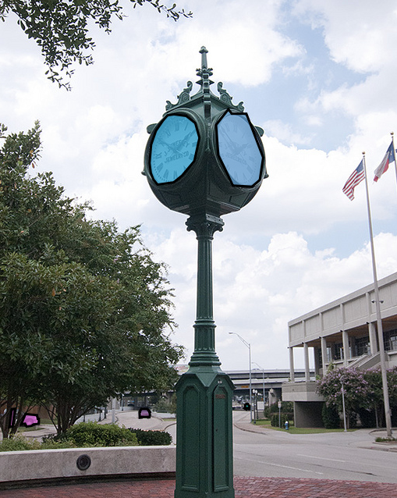
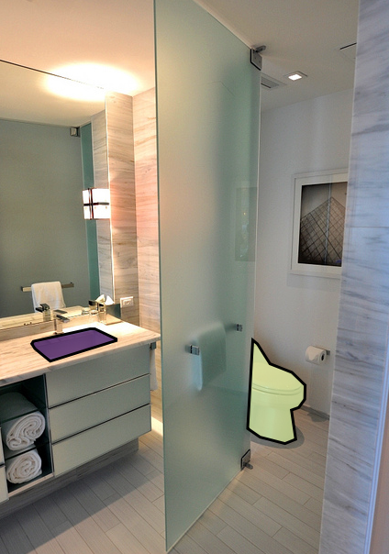
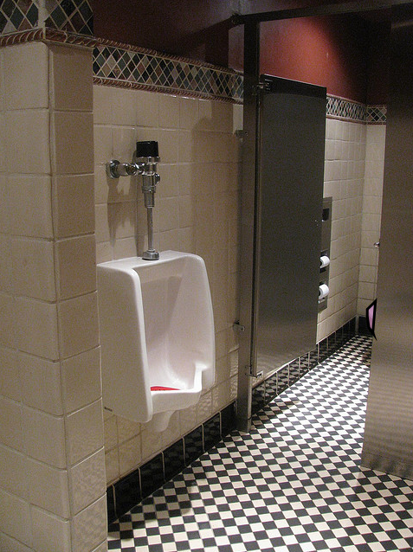
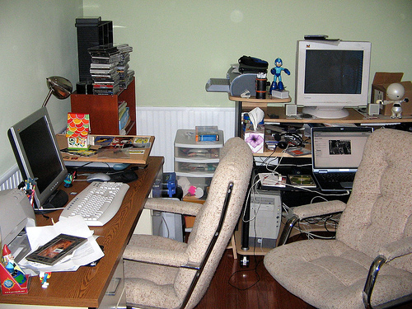
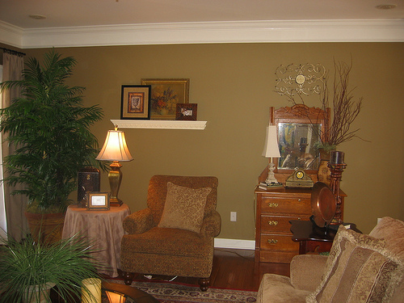
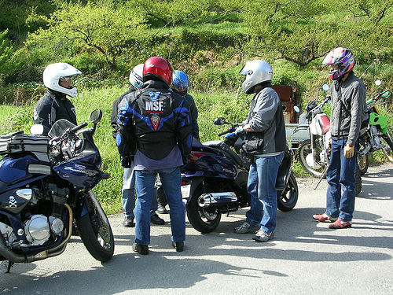
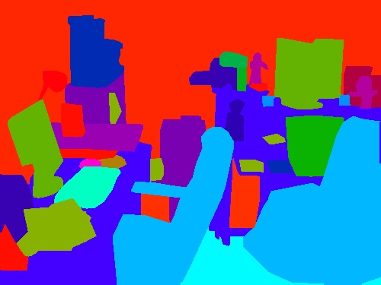
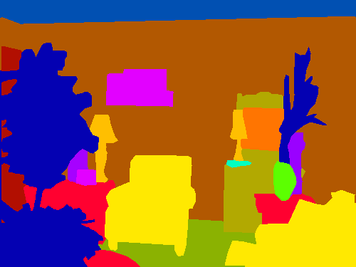
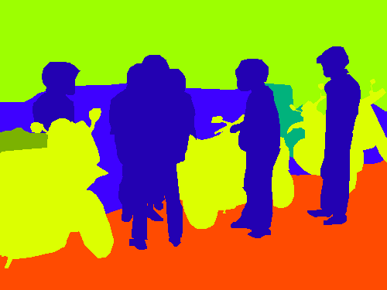


COCO Images
~80 classes
~2M instances
~10,000 classes?
billions of instances?
[Lin et al. ECCV’14] [Mottaghi et al., CVPR’14]
Notes:
but here is what 80 categories look like in our world, even with 2M labeled instances in 300K images, we can only cover <20% of the pixels,
and from a sparse understanding to a more comprehensive understanding, we would likely need tens of thousands of categories, we will potentially need more than billions of instances to achieve a similar performance
it is doubtful that AMT can scale up to this level, so in this work, we are going to focus on how we can train thousands of object detectors directly from web data
but looking at many of the images inside the coco dataset, we can clearly see that even with 90 classes and 2M training instances, the 80 categories only cover <20% of the visual world, and collecting annotation has almost maxed out AMT
but if we have to scale up for complete image understanding, we will need to train thousands of detectors, and in that case will need billions of training instances to achieve a similar performance
then how can we collect such a large amount of data? AMT clearly cannot
in this talk, we are going to focus on how we can train thousands of object detectors directly from web data

Slide 4

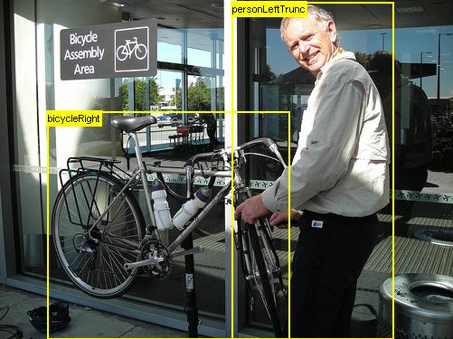
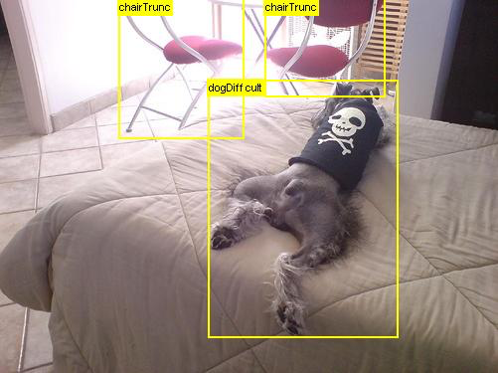
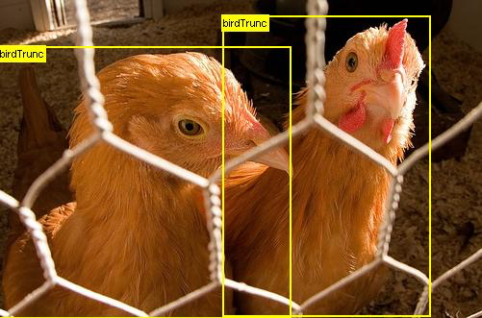
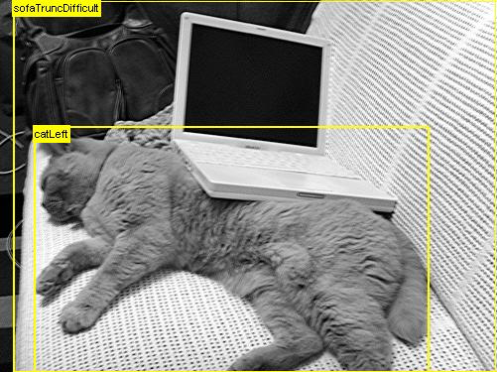
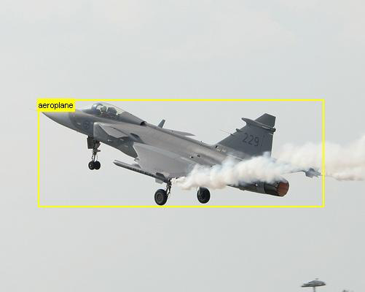
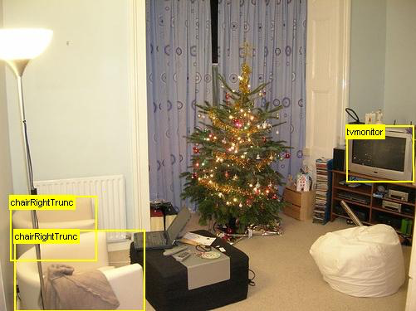
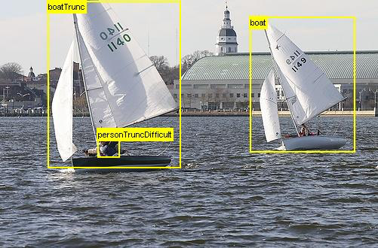
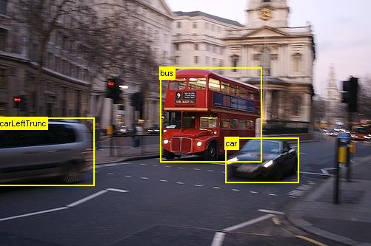
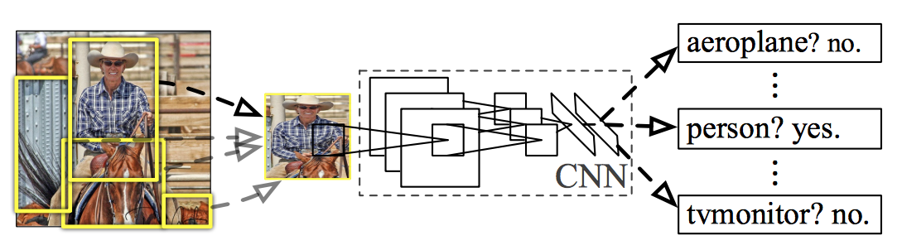
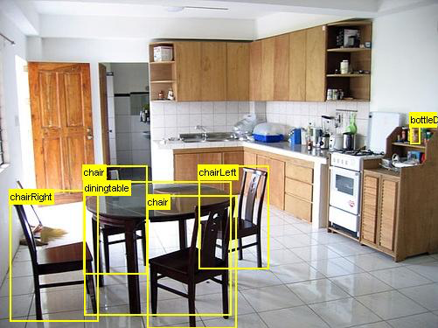
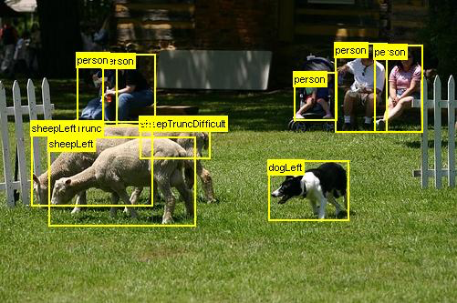
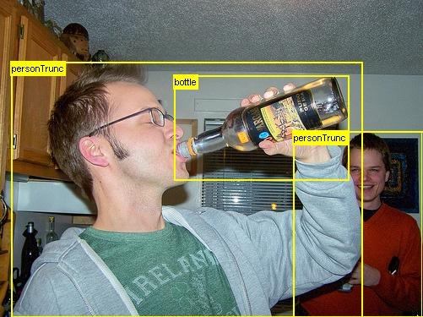
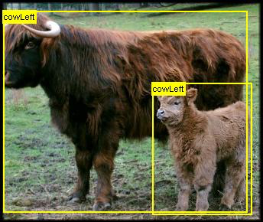
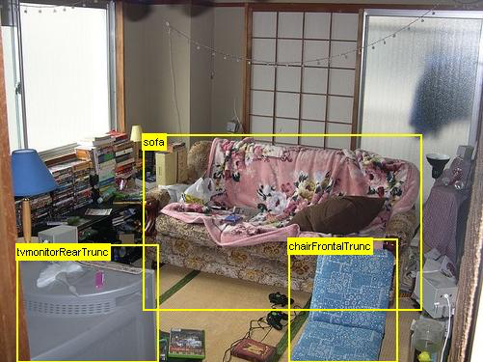

Dissecting R-CNN
features
model
location
boxes
[Chen et al., ICCV’13] [Divvala et al., CVPR’14]
Notes:
to see how we can achieve that goal, let’s first take a closer look at how r-cnn works
first, It uses image level labels to train convnets, then it uses the feature representation in those convnets together with bboxes annotations to train object detectors
therefore, we will shift our attention to how we can use web data directly for these two things
note that previous work only focuses on getting the bboxes, and used manually designed feature representations, here we want to explore how can learn features automatically from the web as well.
[here we want to explore both the features and object models can be learned sly]

Slide 5
1: Features
Representation learning
Notes:
and in fact, this is what we will talk about first, namely training convnets directly from the web data.

Slide 6
Basic Setup
Classes: ImageNet (1K) + NEIL (1.3K)
Class names as Queries & Labels
Architecture: AlexNet
Verification
R-CNN for VOC 2007 object detection
w/o fine-tuning
ImageNet
44.7
[Everingham et al., IJCV’10] [Deng et al., CVPR’09] [Krizhevsky et al., NIPS’12] [Chen et al., ICCV’13]
Notes:
we first introduce the basic settings of our representation learning experiments
we get the list of classes by combining imagenet challenge categories and objects/attributes from NEIL
use class names as queries to retieve images and use them as labels to train CNNs
to verify whether a feature is good or not … we trained R-CNN on top of the VOC 2007 data for detection, without further fine-tuning it
and note that the same network trained on ImageNet achieved an mAP of 44.7

Slide 7
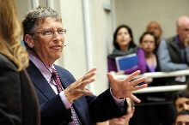
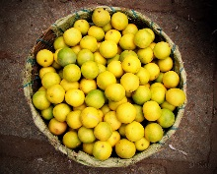
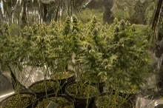


Trial 1: Train Directly
bus
tree
lemon
bill gates
1.2M
ImageNet | FlickrS
44.7 | 38.1
Scratch
40.7
[Agrawal et al.,ECCV’14]
Notes:
the first thing we tried is to train the network directly,
and since most pascal voc data is collected from Flickr, we used 1.2M images from Flickr to train the network
pascal voc data
….
so clearly it does not work as expected

Slide 8
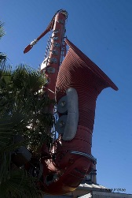
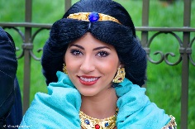
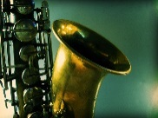
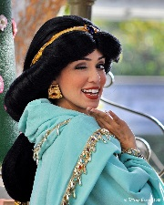

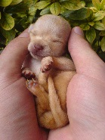
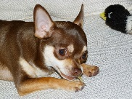
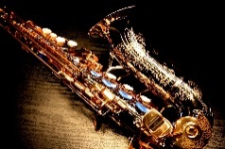
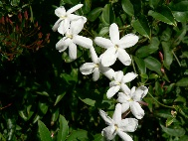
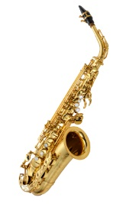

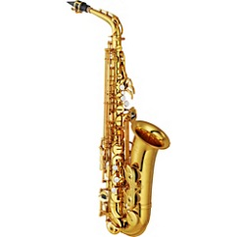
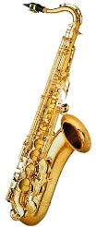

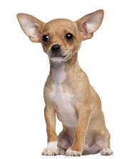



Why? Observation
Notes:
why that is the case? one observation that can potentially explain this is that Flickr images it is hard to train with… for example, cluttered background…
cluttered background, difficult view points,
but on the other hand, there are images online, in particular search engines
white/easy background, cannonical view points, limited generalization power but easier to learn
these two types of data are complementary to each other

Slide 9

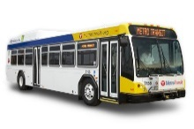
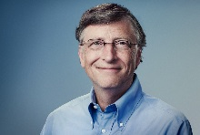
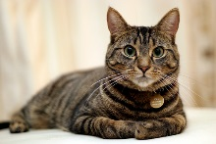

Trial 2: More Data
bus
tree
lemon
bill gates
cat
bill gates
bus
yellow
1.5M
ImageNet | FlickrS | GFAll
44.7 | 38.1 | 40.5
Notes:
information complementary, so as the next step toward our goal, we added another 1.5M images from google and trained our network
still not as good, but did see a performance gain

Slide 10
Trial 3: Google Alone
cat
bill gates
bus
yellow
ImageNet | GFAll | GoogleO
44.7 | 40.5 | 42.7
Notes:
so just out of curiosity, we would like to see the performance of just using the google data alone
despite the easiness, google images can converge the network better, but it can still have limited generalization power, so how to fix the gap?

Slide 11
Trial 4: Staged Training
cat
bill gates
bus
yellow
bus
tree
lemon
bill gates
ImageNet | GoogleO | FlickrF
44.7 | 42.7 | 43.4
[Bengio et al., ICML’09]
Notes:
the simple way to fix this is just to perform fine-tuning… 43.4
so this is good, but the performance gain is not that significant, why? our assumption is that Flickr can bring the representation closer to pascal voc, but the noise in the label is also distracting the fine-tuning process,
how to combact the noise?

Slide 12
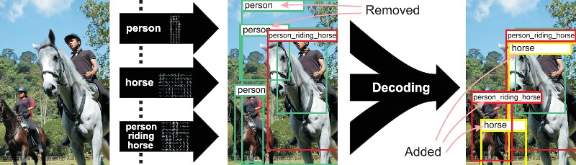
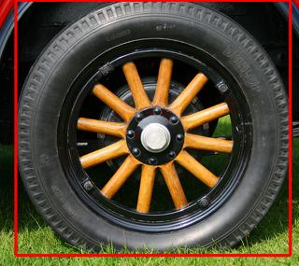
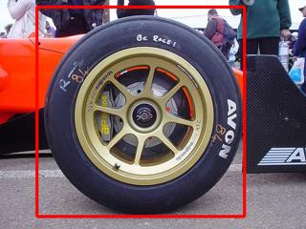
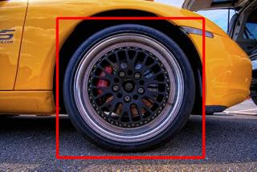




Higher-Order Constraints
[Carlson et al., AAAI’10]
[Farhadi & Sadeghi, CVPR’11]
Dog
Corgi
Puppy
Cat
Wheel is/has Round shape
Dog
Cat
Dog
0.9
Corgi
0.8
Puppy
0.9
Sparrow is a kind of/looks
similar to bird
Eye is a part of Baby
Cat
Corgi
Puppy
0.1
[Chen et al., ICCV’13]
[Deng et al., ECCV’14]
[Marszalek & Schmid, CVPR’07] [Gupta et al. ECCV’08] [Lampert et al., CVPR’09] [Lee & Grauman, TPAMI’12] [Shrivastava et al., ECCV’12] [Zhu et al., ECCV’14] [Feng et al., AAAI’15] [Ramanathan et al., CVPR’15]
Notes:
looking at the literature, we find that many related works have come up with ways to combat noise, and one of the most prominent one is to use higher order statistics to constrain the learning process…
so in this work we want to see such an idea can be applied when fine-tuning the network

Slide 13

Final Approach: Staged + Graph
cat
bill gates
bus
yellow
bill gates
school
bus
tiger
cat
lemon
yellow
bus
person
bus
tree
lemon
bill gates
Notes:
so during the fine-tuning process, we add a relationship graph on top of the network to encode the higher-order statistics
instead of softmax, designed a loss which uses the relationship graph to only penalize for categories that do not look similar, only penalize very bad mistakes
tabby images -> tiger, no P, but if predict bus, big P
and the loss function is designed in a way to penalize the network if it makes mistakes out side of the similar-looking categories
this is all good, but the only question is, how to design the relationship graph itself? in this work we only focus on relationships without spatial displacements

Slide 14













































Graph: Confusion Matrix
Category
house finch
bayon
temple
pharmacist
tree
rabbit
muzzle
van
plain
bossa nova
sparrow
angkor
lab coat
banyan
hare
malinois
camionnette
open area
guitar
indigo bunting
obelisk
doctor
buckeye
wood rabbit
german
shepherd
club wagon
rapeseed
downbeat
Similar/Confusing Categories
baya weaver
stupa
tobacco shop
natural
angora
bull mastiff
minibus
valley
ukulele
goldfinch
megalith
stethoscope
tree stump
wallaby
doberman
toyota hiace
sky
cello
Notes:
how do we build the relationship graph?
we use the confusion matrix, so for example house finch is mostly confused with sparrow and gold finch, we will add it to the related categories
we find such a strategy produce reasonable similar looking categories across different accuracies
an simple idea is to take the confusion matrix of the training data…
regardless of the accuracy, the confused categories are mostly reasonably related to the category of interest
so we build a relationships graph with top-5 nearest neighbors

Slide 15
Final Approach: Staged + Graph
cat
bill gates
bus
yellow
bill gates
school
bus
tiger
cat
lemon
yellow
bus
person
bus
tree
lemon
bill gates
ImageNet | FlickrF | FlickrG
44.7 | 43.4 | 44.7
Notes:
on par with imagenet

Slide 16
With VOC Fine-Tuning?
Year | ImageNet | GoogleO | FlickrG
2007 | 54.2 | 53.1 | 53.3
2012 | 52.3 | 52.4 | 52.7
Notes:
now that we have found a good representations, how does it perform with VOC finetuning ….
competitive results
voc2007: slightly worse than the imagenet pretrained models
voc2012: better

Slide 17
2: Location Boxes
Simultaneous localization and cleanup
Notes:
how we can use those features to localize objects in web images

Slide 18





Step 1: E-LDA Training
covariance
-1
(
−
)
mean
Seeds
fc7
E-LDAs
[Hariharan et al., ECCV’12]
Notes:
for each class, for example a mini-cooper…
train exemplar elda detectors

Slide 19
























Step 2: Get Top Detections
Fire
EdgeBox Proposals
Seeds
E-LDAs
Top Detections
[Zitnick & Dollar, ECCV’14]
Notes:
fire on the rest of the images to look for nearest neighbors/top detections,
note that for good images where objects centered and there is little background, they can find good, consistant nearest neighbors,
but for bad ones where there is noise, it cannot find good top detections and they are removed
these top detections form our initial clusters
note that we do not apply it in a sliding window fashion, but only on big proposals by edge box, which can potentially speed up the process and reduce false positives
clutterd image/noise it cannot find, so purged.

Slide 20
Step 3: Merging
Cluster-1
Cluster-2
Top Detections
Bounding boxes
Notes:
heretical clustering based on the similarities between these initial clusters, to form the final sets of clusters

Slide 21





































Sample Results
alligator lizard
polo ball
expedition
lychee
Notes:
shoes made out of the animal’s skins
captures more variance in each cluster compared to previous methods

Slide 22
1 + 2: Detector Training
R-CNN using CNN features & bounding boxes from the web
Notes:
finally, we combine features and bounding boxes to train our detectors

Slide 23


Positive/Negative
Basic, use discoverd locations (FlickrG)
EdgeBox Augmentation (EA)
Add proposals (IoU >= 0.5)
Category Expansion (CE)
Add categories if they are similar
Negative
Random patches from Flickr 100M
LEVAN | FlickrG | FlickrG-EA | FlickrG-CE
17.1 | 22.9 | 23.0 | 24.4
[Zitnick & Dollar, ECCV’14] [Divvala et al., CVPR’14]
Notes:
also add proposals in the training set if they have an overlap larger than 0.5 as positives
compared to the previous state-of-the-art, we achieved a big performance gain

Slide 24




















False Positives (Flickr-CE)
plane
bottle
bike
person
“caprice”
[Hoeim et al., ECCV’12]
Notes:
We show the false positives…For some category, likes planes and bottles, localization is an issue and for categories like bike and person semantic drift is an issue….
we also did analysis of our best performing model using the tools from hoeim et al,
localization error is a big factor here, especially for categories like bottle, because images online tend to have multiple bottles occur together frequently
another interesting thing is semantic drifting, for example bike can refer to both …
caprice -> chevy caprice, describe a girl, and

Slide 25
Summary
features
Can learn good features from the noisy web data directly
Staged training & Graph can help
model
location
boxes
alligator lizard
polo ball
Significantly improves web detectors
Main issue: localization & semantic drift
Notes:
in conclusion,
we have presented an approach to learn both features and .. for training state-of-the-art object detectors
for features we show

Slide 26
Thank you!
Code & Models will be available soon!

Slide 27


Trial 2: More Data
tabby
bus
yellow
bill gates
1.5M
person
tiger
bus
bill gates
1.2M
lemon
lemon
Notes:
to achieve a better method, we try to augment the Flickr data with images from Google…

Slide 28
Verify Representations
Object detection w/o fine-tuning, VOC 2007
Does staged training help?
Does graph regularization help?
Allow fine-tuning lower layers?
ImageNet | GoogleO | FlickrG
44.7 | 42.7 | 44.7
FlickrS | GFAll
38.1 | 40.5
FlickrF
43.4
ImageNet | Scratch | FlickrG
54.2 | 40.7 | 53.3

Slide 29
Verify Representations
Object detection w/ fine-tuning, VOC 2012
Scene classification, MIT Indoor 67
ImageNet | ImageNet-TV | GoogleO | FlickrG
49.6 | 52.3 | 52.4 | 52.7
ImageNet | ImageNet-TV | GoogleO | GoogleA
56.8 | 58.1 | 59.2 | 66.5
GoogleA
Images from GoogleO
Additional scene images from Google
874 classes
0.6M images

Slide 30



Detection Pipeline
car
chair
table
bike
horse
person
…
image
labels
list
features
1
raw
data
location
boxes
model
2
Notes:
let us see r-cnn works?
first, It uses imagelevel labels to train convnets
then it uses the feature representation in those convnets and uses bboxes to train an OD

Slide 31

Our approach
onion
building
rhino
eiffel tower
iphone
delta
…
1
list
features
raw
data
location
boxes
model
2
[Chen et al., ICCV’13] [Divvala et al., CVPR’14]
Notes:
in this talk, we are going to obtain both the feature … and the bounding boxes directly from the web data
note that previous works only focus…

Slide 32
Detection Pipeline
car
chair
table
bike
horse
person
…
image
labels
list
features
1
raw
data
location
boxes
model
2
[Hoffman et al., NIPS’14] [Hoffman et al., CVPR’15]

Slide 33


Slide 34
Trial 1: Directly from Source
bus
bill gates
1.2M
lemon
lemon
ImageNet | Scratch | FlickrS
44.7 | 40.7 | 38.1
Notes:
pascal voc data
….
bring it on the side 40.7
so clearly it does not work as expected

Slide 35
Trial 1: Train Directly
bus
tree
lemon
bill gates
1.2M
ImageNet | FlickrS
44.7 | 38.1
Scratch
40.7
Notes:
the first thing we tried is to train the network directly,
and since most pascal voc data is collected from Flickr, we used 1.2M images from Flickr to train the network
pascal voc data
….
so clearly it does not work as expected

Slide 36
Trial 2: More Data
tabby
bus
yellow
bill gates
1.5M
person
tiger
bus
bill gates
1.2M
lemon
lemon
ImageNet | Scratch | FlickrS | GFAll
44.7 | 40.7 | 38.1 | 40.5
Notes:
still not as good, but we did see a performance gain

Slide 37
Trial 3: Google Alone
tabby
bus
yellow
bill gates
1.5M
person
tiger
ImageNet | Scratch | GFAll | GoogleO
44.7 | 40.7 | 40.5 | 42.7
Notes:
so just out of curiosity, we would like to see the performance of just using the google data alone
and somewhat to our surprise, it actually performs really well, regardless of the seemly easy images

Slide 38
Trial 4: Staged Training
tabby
bus
yellow
bill gates
1.5M
person
tiger
bus
bill gates
1.2M
lemon
lemon
ImageNet | Scratch | GoogleO | FlickrF
44.7 | 40.7 | 42.7 | 43.4
Notes:
however, easy images are easy ones, the distribution can still be quite different from the ones we see on pascal, so how to fix the gap?
the simple way to fix this is just to perform fine-tuning… 43.4
so this is good, but how can we do better? here we did find a small performance gain, but maybe this gain could be much better if we can somehow combat the noise in the data
how to do that?

Slide 39
Previous Work
Sparrow is a kind of/looks
similar to bird
Eye is a part of Baby
Relationship Constrained
Learning!
Wheel is/has Round shape
[Shrivastava et al., ECCV’12] [Chen et al., ICCV’13]
Notes:
previous work has shown that relationships can help a lot to constrain the learning process and alleviate concept drifting in the semi-supervised setting
so in this work we want to see such an idea can be applied when fine-tuning the network

Slide 40
Higher-Order Constraints
football
uses equipment
climbing
Canada
skates
helmet
Miller
Sunnybrook
uses equipment
country
hospital
Wilson
city company
politician
CFRB
hockey
Detroit
GM
Pearson
radio
Toronto
hired
play
hometown
competes with
airport
home town
NELL
city company
Maple Leafs
Stanley Cup
Red Wings
city stadium
won
won
team stadium
Toyota
Connaught
city paper
league
league
city stadium
Maple Leaf Gardens
member
NHL
acquired
Hino
created
plays in
economic
sector
Globe and Mail
Sundin
writer
Toskala
automobile
Prius
Skydome
Milson
Corrola
NEIL
Wheel is/has Round shape
[Carlson et al., AAAI’10] [Shrivastava et al., ECCV’12] [Chen et al., ICCV’13]
Notes:
looking at the literature, we find that many related works have come up with ways to combat noise, and one of the most prominent one is to use higher order statistics to constrain the learning process…
so in this work we want to see such an idea can be applied when fine-tuning the network

Slide 41

















Sample Results
alligator lizard
hulk
polo ball
tv
Notes:
captures more variance in each cluster compared to previous methods

Slide 42























Sample Results
expedition
kelpie
lychee
zopf
Notes:
captures more variance in the representation compared to previous methods

Slide 43
Trial 5: Combat Drifting
tabby
bus
yellow
bill gates
1.5M
person
tiger
Bill Gates
School
bus
Tiger
Tabby
Lemon
1.2M
Yellow
Bus
Person
ImageNet | Scratch | FlickrF | FlickrG
44.7 | 40.7 | 43.4 | 44.7
bus
bill gates
lemon
lemon
Notes:
now that we have found a good representations, how does it perform on VOC….

Slide 44
Dissecting R-CNN
features
model
location
boxes
[Fergus et al., ICCV’05] [Berg & Forsyth, CVPR’06] [Vijayanarasimhan & Grauman, CVPR’08]
[Fan et al., CVPR’10] [Li & Li, IJCV’10] [Torresani et al., ECCV’10] [Li et al., CVPR’13]
[Chen et al., ICCV’13] [Divvala et al., CVPR’14] [Golge & Duygulu, ECCV’14] [Xia et al., ECCV’14]
Notes:
to see how we can achieve that goal, let’s first take a closer look at how r-cnn works
first, It uses image level labels to train convnets, then it uses the feature representation in those convnets together with bboxes annotations to train object detectors
therefore, we will shift our attention to how we can use web data directly for these two things
note that previous work only focuses on getting the bboxes, and used manually designed feature representations, here we want to explore how can learn features automatically from the web as well.
[here we want to explore both the features and object models can be learned sly]

