Slide 1
NEIL: Extracting Visual Knowledge from Web Data
Xinlei Chen, Abhinav Shrivastava, Abhinav Gupta
Carnegie Mellon University

Slide 2
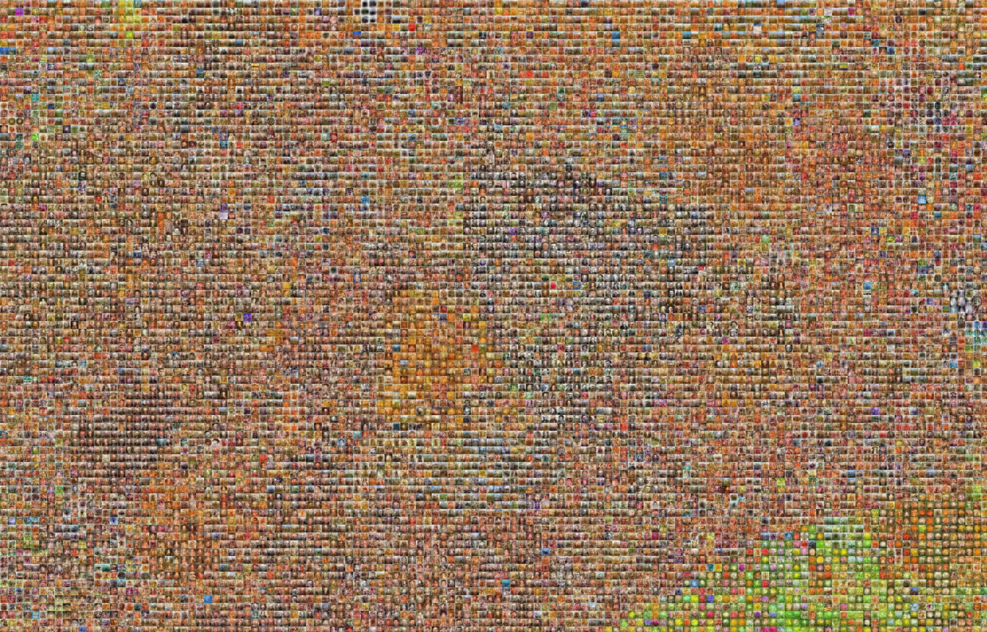


Lots of labeled data & common-sense relationships
have helped improve performance!
….
But how do we label data and
collect common sense at a large scale?
[Everingham et al., IJCV’10], [Xiao et al., CVPR’10], [Deng et al., CVPR’09], [Gupta et al. ECCV’08],
[Farhadi et al., CVPR’09], [Lampert et al., CVPR’09], [Parikh et al., ICCV’11], [Shrivastava et al., ECCV’12]
Notes:
Lots of labeled data and common-sense knowledge have helped CV a lot..
While the labeled data has been evident, the CS knowledge has usually been hidden in the form of contextual modeling, graphical models and even in relationships between object and attributes
One big question is how do we label data and collect such CS knowledge…
- Lots of labeled data and Lots of common-sense relationships for example between objects and attributes
- Have helped CV over the past decade.
- How do we label data and collect common sense relationships, at a large scale?
Hidden behind so far…
Lots of labeled data and common-sense knowledge hidden in the form of contextual modeling, graphics models and even relationships between object and attributes, have helped CV a lot..
Over the past decade, lots of labeled data and common-sense relationships has helped…
This CS knowledge has been captured in the form of contextual modeling, graphics models and even relationships between object and attributes..

Slide 3



Labeled Data:
Common Sense Relationships:
Notes:
So far, we have …. to label images.
And when it comes to CSR, there are efforts like CYC which use
Human experts to list down CS knowledge..…

Slide 4
Labeled Data:
Common Sense Relationships:
Notes:
So far, we have …. to label images.
And when it comes to CSR, there are efforts like CYC which use
Human experts to list down CS knowledge..…

Slide 5



Labeled Data:
1M Boxes
5 years
400M images
daily!
?
Common Sense Relationships:
2M Rules
30 years
and still continuing…
Notes:
For E.g., ImageNet has 1M labeled BB in 5 years.. & CYC has collected 2M rules in past 30 years, and still continue to collect..
Now compare this to
And when it comes to common-sense, We still don't know how to quantify, how much would we need…
Do we need 10M, 100M ….
In this paper, we propose an alternative approach

Slide 6
NEIL
Never Ending Image Learner
Running
24 hours a day,
7 days a week
Trying to understand images on the
web and build world’s largest
Visual Knowledge Base
automatically…
Notes:
Computer program that runs …
As I’m talking
While its running, download
Understand those images and
Build … visual knowledge base..
So let us see what NEIL KB looks like:

Slide 7
NEIL’s Knowledge Base
Concepts
Relationships
Notes:
NEIL’s KB consists of Concepts and Relationships..

Slide 8
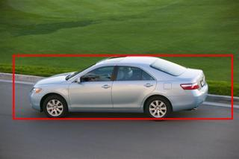
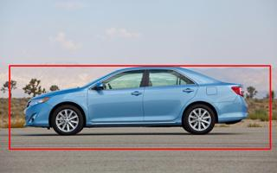
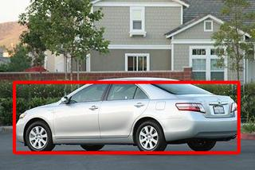
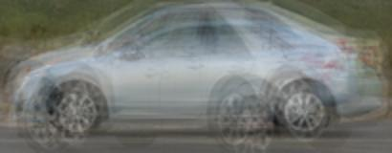
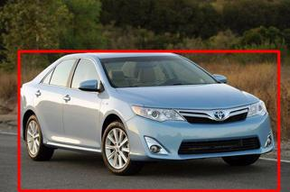
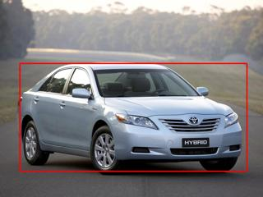
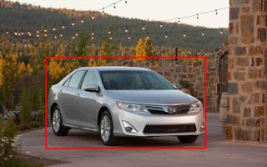
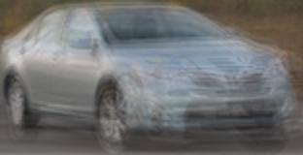
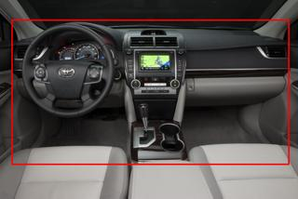
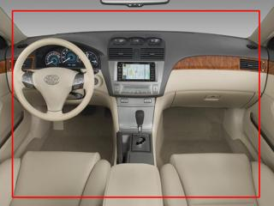
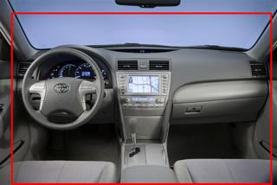
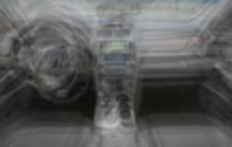
Objects
Camry
Notes:
Separate and label different visual meanings of the word Camry
Which can correspond to different viewpoints or
even indoors of the car..

Slide 9
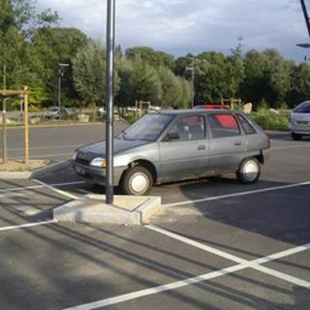
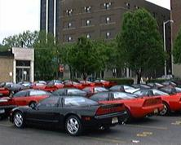
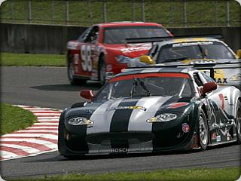
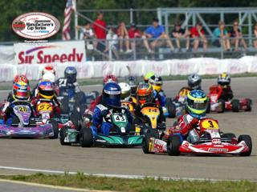
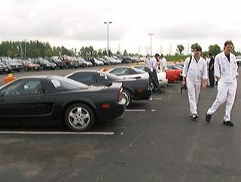
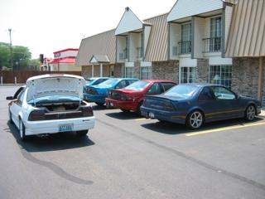
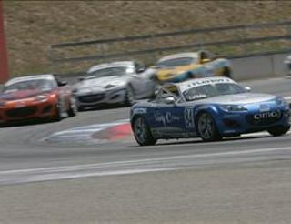
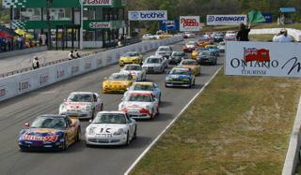
Scenes
Parking Lot
Raceway

Slide 10
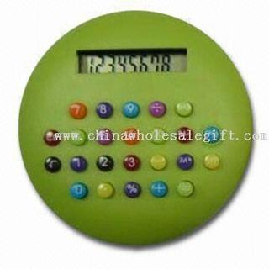
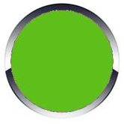
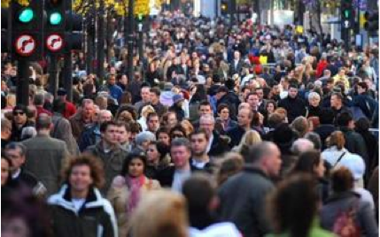
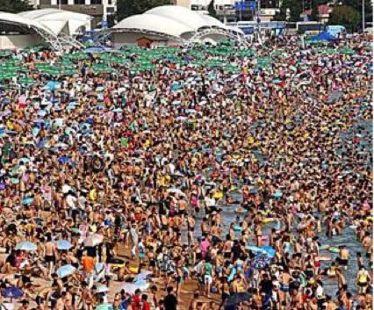

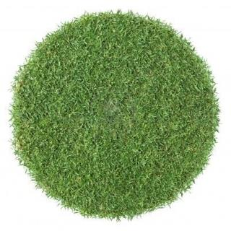
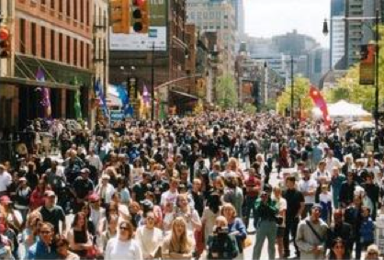
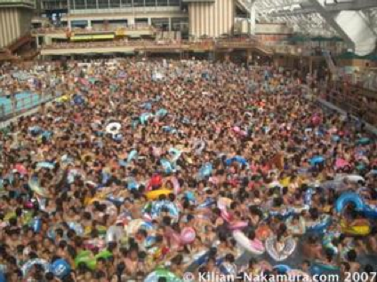
Attributes
Round Shape
Crowded

Slide 11
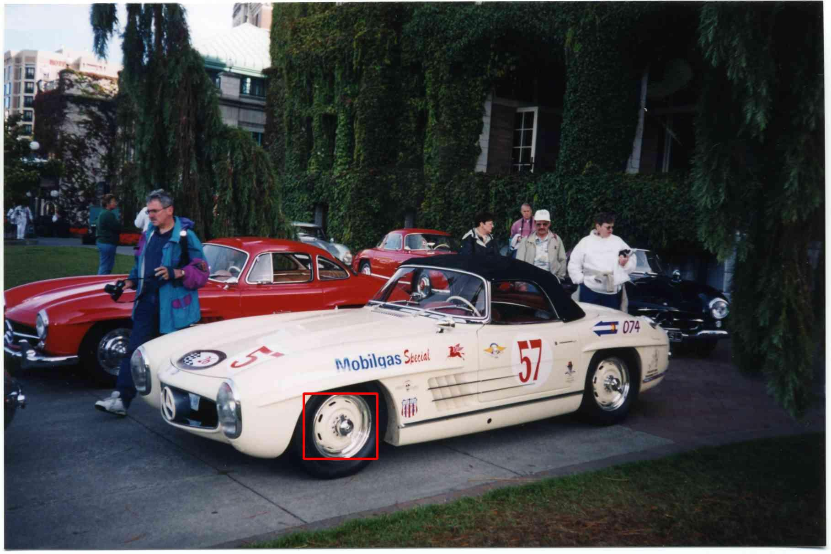
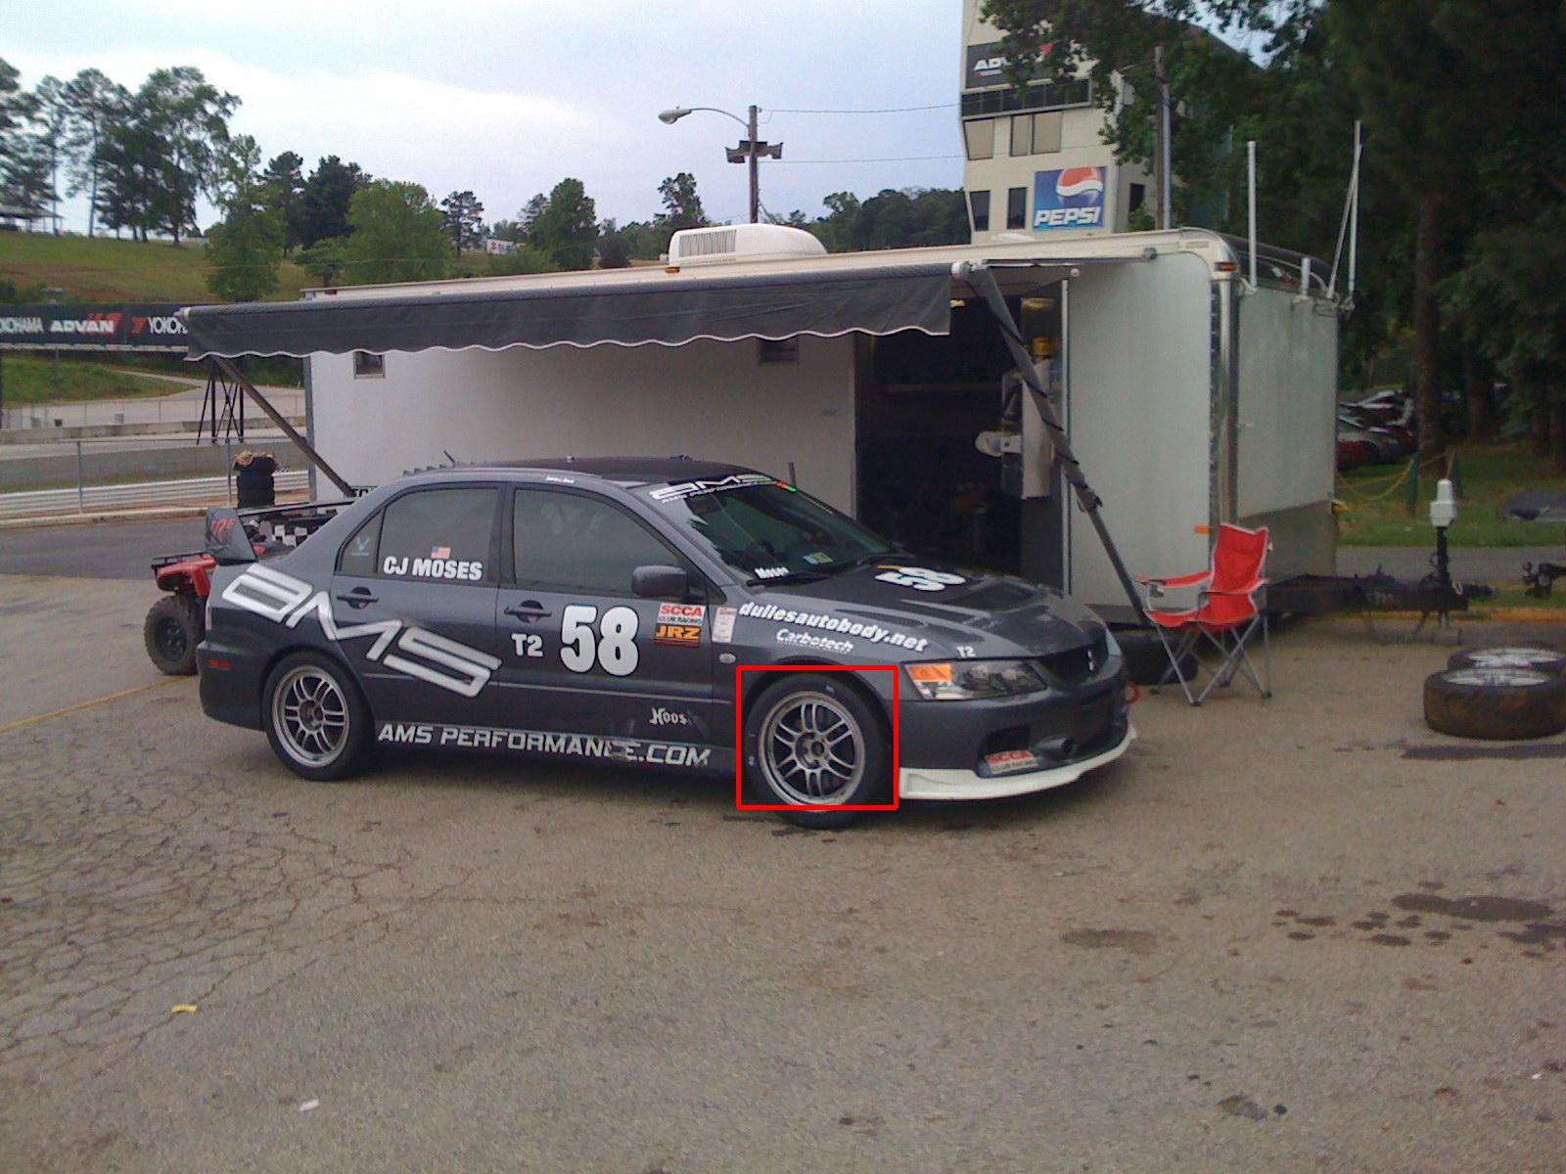
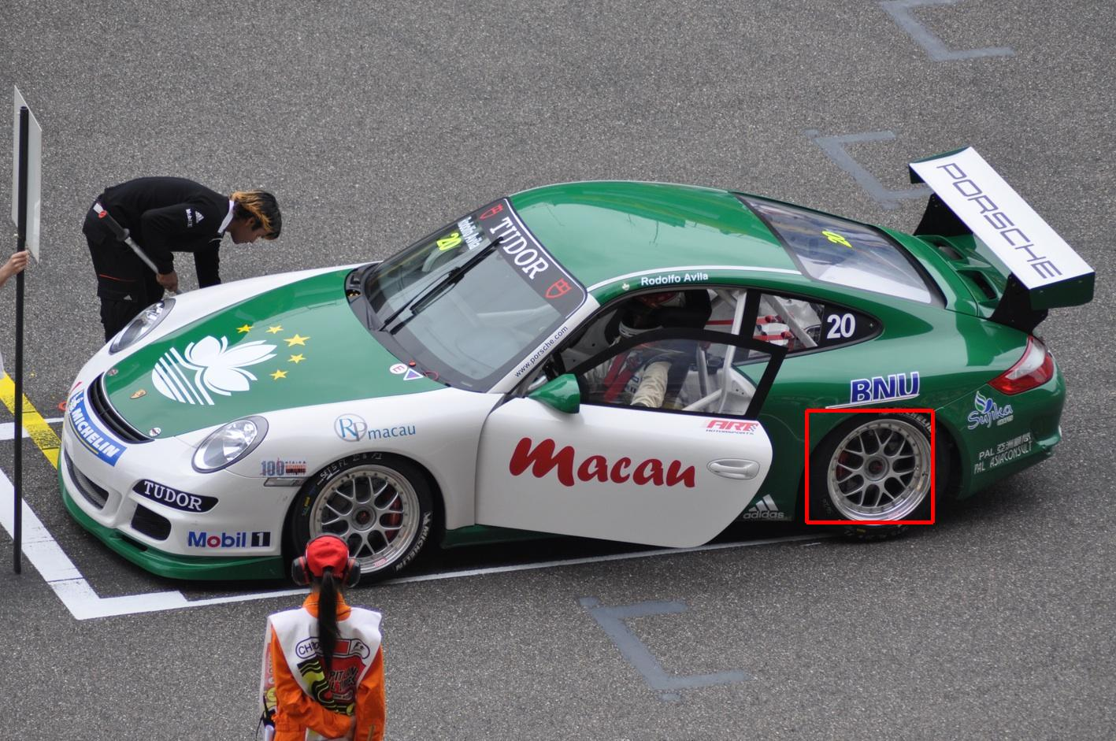
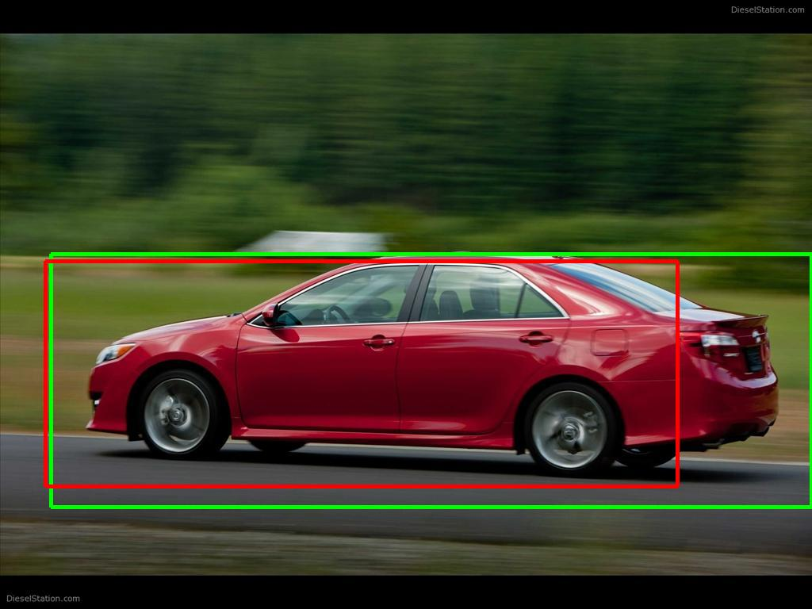
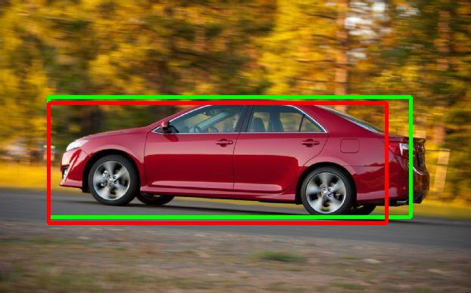
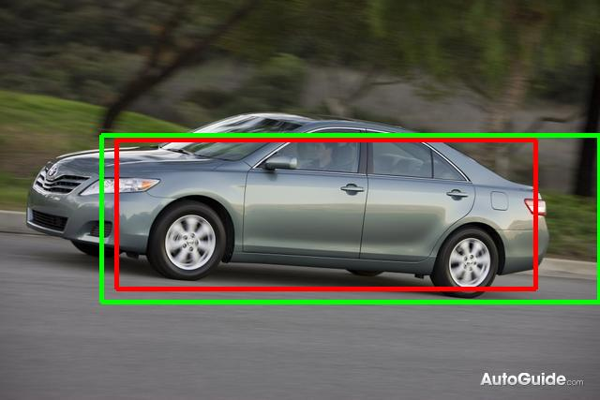
Relationships
Object - Object
Partonomy
Wheel is a part of Car
Taxonomy
or
Similarity
Corolla is a kind of/looks similar to of Car
Notes:
O-B
E.g.,

Slide 12
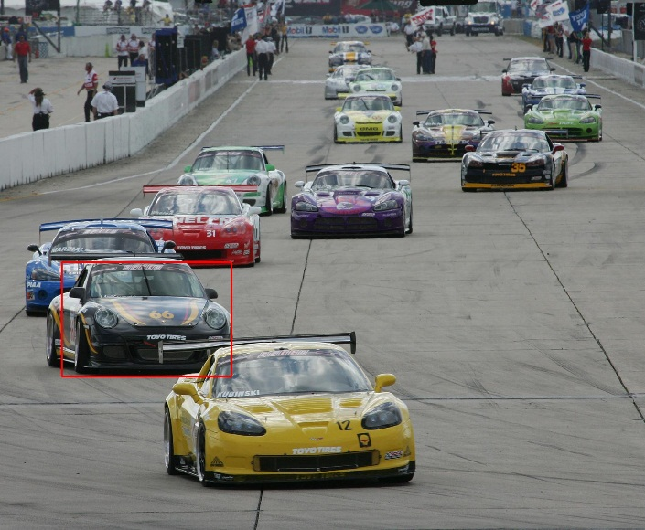
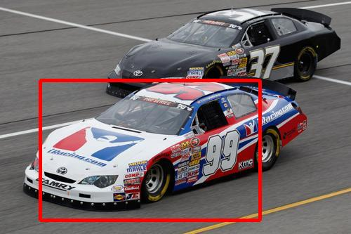
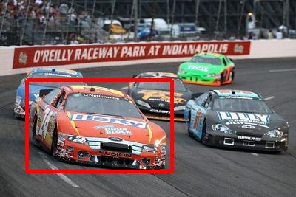
Relationships
Object - Scene
Car is found in Raceway

Slide 13
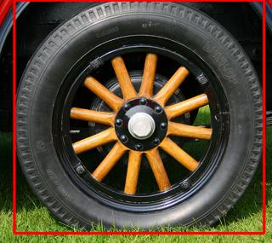
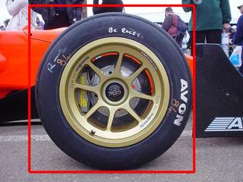
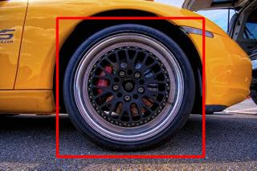
Relationships
Object - Attribute
Wheel is/has Round shape

Slide 14
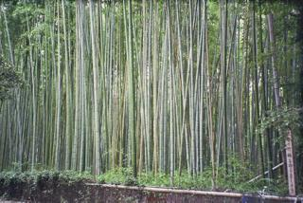
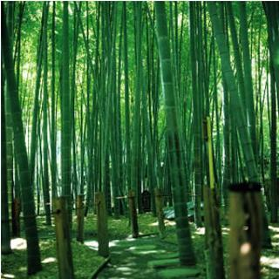
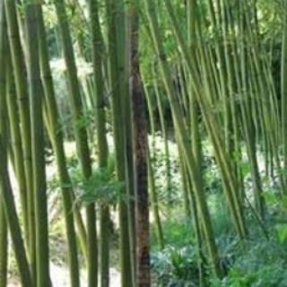
Relationships
Scene – Attribute
Bamboo forest is/has Vertical lines

Slide 15
NEIL’s Knowledge Base
Concepts
Relationships
Objects
Scenes
Attributes
Object-Object
  Partonomy, Taxonomy/Similarity
Object-Scene
Object-Attribute
Scene-Attribute
(Provided by Text Analysis)
Notes:
These concepts, e.g., the word “Car”, are currently provided by a text analysis system.
And only 5 kind of relationships between these concepts..
Now I would like to point out, that when it comes to common-sense; it’s much more diverse.. But this paper is just the first step in collecting common-sense..
The word “car” can be either provided manually or by a text analysis system.. And NEIL uses Text analysis to obtain these words…
And only 5 kind of relationships between these concepts..

Slide 16
NEIL
Never Ending Image Learner
www.neil-kb.com
4 months on 200 cores
>2500 Concepts
  >1500 Objects
  >1034 Scenes
  >87 Attributes
>5 million images analyzed
Labeled
  600K images
  3000 relationships
Train Your
Own Concept!
Notes:
You can request training a new concept on our website.

Slide 17
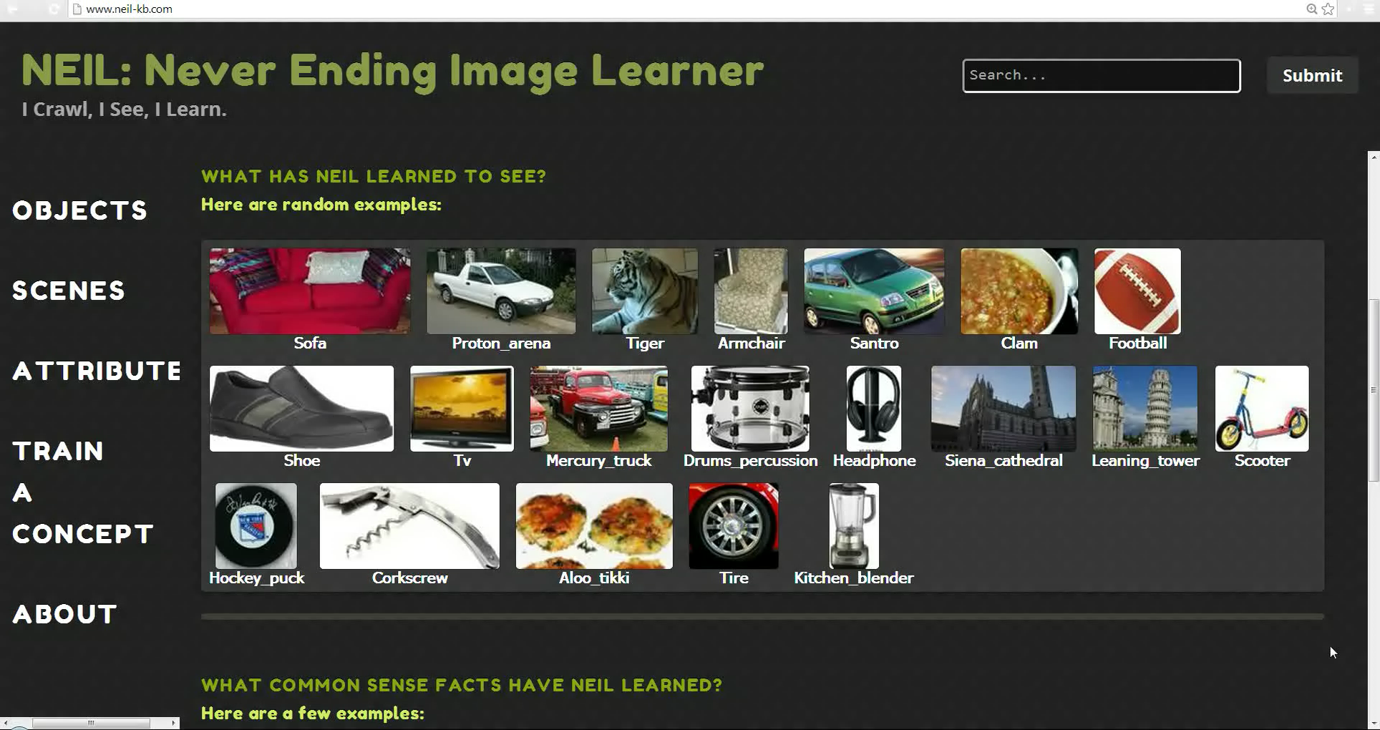

Slide 18
NEIL
Never Ending Image Learner
www.neil-kb.com
4 months on 200 cores
>2500 Concepts
  >1500 Objects
  >1034 Scenes
  >87 Attributes
>5 million images analyzed
Labeled
  600K images
  3000 relationships
Notes:
Now X, the first author will tell you more about NEIL..

Slide 19
Why does NEIL work?

Slide 20
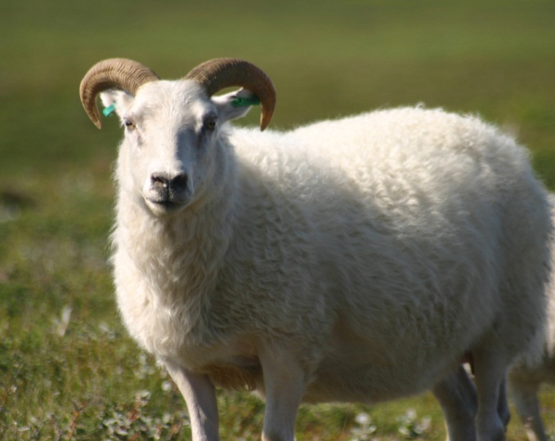
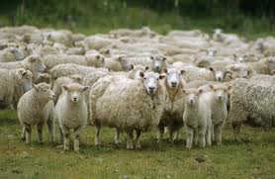
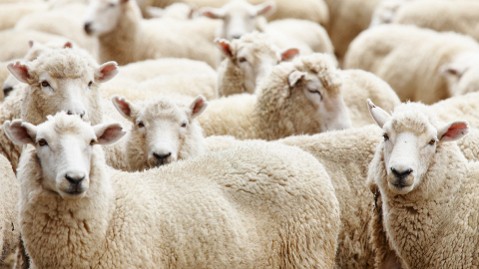
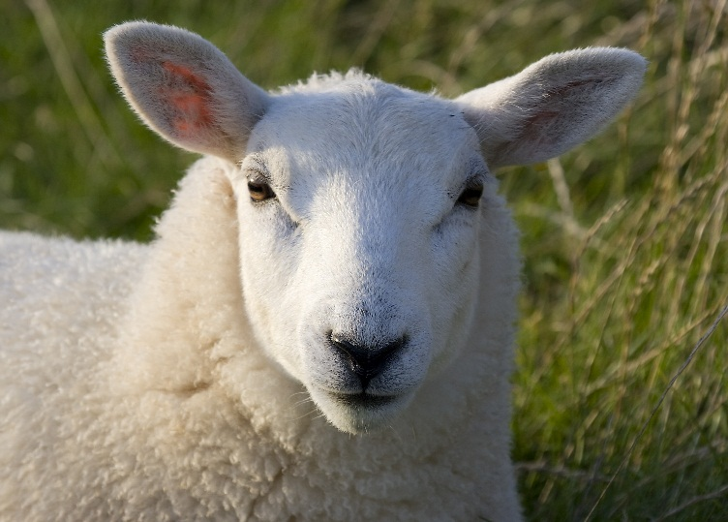
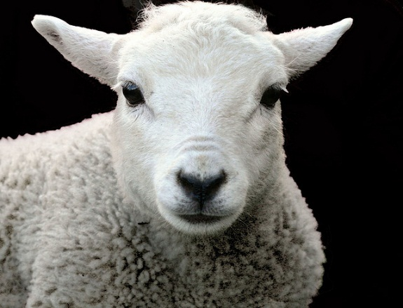
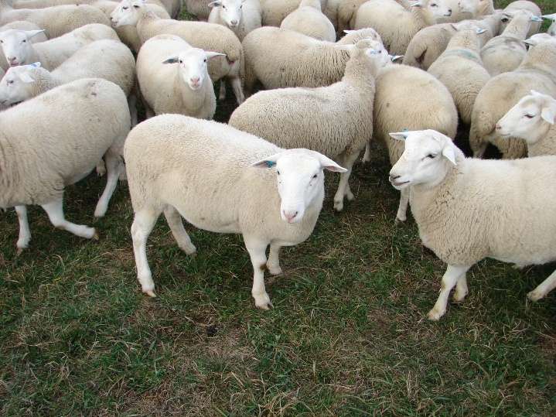


Micro-vision
Notes:
In the traditional setting, what we call micro vision, a sheep detector that fires only on 5 out of hundreds of sheep is not considered good

Slide 21

Micro-vision
Notes:
In the traditional setting, we are required to understand every image that is given to the system, and that makes the task extremely difficult

Slide 22

Macro-vision
Notes:
But imagine if you have millions of images, the sheep detector can still do a decent job by finding thousands of sheep. And we can still learn something about it like sheep are white. Neil is built on such an idea called macro vision, in macro vision, we have a lot of data and our goal is not to understand each and every image The set of images that are easy to understand. We can just use them to build statistics and learn relationships

Slide 23




Structure in the Visual World
Car is found on Street
Sheep are White
Constrained
Semi-supervised Learning
Notes:
Really boring
What neil does

Slide 24



Semantically-driven Acquisition
Yoda
[Fergus et al. ECCV’04], [Berg et al. CVPR’06], [Snavely et al. SIGGRAPH’06], [Schroff et al. ICCV’07], [Simon et al. ICCV’07], [Hays et al., CVPR’08], [Li et al. ECCV’08], [Shrivastava et al. ToG’11], [Rubenstein et al. CVPR’13] ...
Notes:
Leverage any text-based image search engines to obtain data
Yoda
A lot of research on learning from Internet images,
We’d like to point out the neil is different. Because uses macro vision to extract common sense relationships, and use them to constrain the learning process

Slide 25
How does NEIL work?

Slide 26









































(0) Seed Images
No Bounding-boxes
Noise
Multiple Meanings (Polysemy)
Desktop Computer
Monitor
Keyboard
…
Notes:
Given a set of concepts, like desktop computer, we first query google to get a few seed images
But if we directly use these seed images to build models, there might be three problems
Where the object is

Slide 27























Desktop Computer
Monitor
Keyboard
Television
(1)
(1)
(1)
(1)
(2)
(2)
(2)
(2)
(3)
(3)
(3)
(3)
(0) Seed Images
(1) Subcategory Discovery
Desktop Computer
Monitor
Keyboard
…
Notes:
Overcome these problems, neil first performs subcategory discovery, and to do that

Slide 28











Exemplar Detectors
Car
Notes:
Neil first rains a detector for each image, and then fire it on the remaining images to get top detections on the right.
Take the car as an example, you can see when the car is zoomed-in, it can find nicely-aligned bounding boxes
But if the image also includes background clutter, or it simply contains noise, it can hardly find good detection
So we just get rid of the bad detectors and only use the good ones to build an affinity graph

Slide 29


























































Affinity Graph
Notes:
In this graph, each BB is one node, the bounding boxes that share the same detector are connected. You can see this graph already has very good cluster structures, so we just run affinity propagation to get the visual clusters.

Slide 30












Polysemy
Falcon
Notes:
Here are the subcategories discovered for the concept falcon,
You can see that neil successfully discovered three meanings of it, the bird, the motorcycle, and the car

Slide 31

Desktop Computer
Monitor
Keyboard
Television
(1)
(1)
(1)
(1)
(2)
(2)
(2)
(2)
(3)
(3)
(3)
(3)
(0) Seed Images
(1) Subcategory Discovery
(2) Train Models
Desktop Computer (1)
Desktop Computer (2)
Desktop Computer (3)
…
Monitor (1)
…
Desktop Computer
Monitor
Keyboard
…

Slide 32

Train Models
Latent SVM
  Objects, Attributes
  CHOG
Linear SVM
  Scenes, Attributes
  Color, Texton, HOG, SIFT, GIST
… Your model?
Notes:
After subcategory discovery, we simply train a model for each of the cluster,
It can be latent svm, linear svm, or any model that works

Slide 33


Desktop Computer
Monitor
Keyboard
Television
(1)
(1)
(1)
(1)
(2)
(2)
(2)
(2)
(3)
(3)
(3)
(3)
(0) Seed Images
(1) Subcategory Discovery
(2) Train Models
Desktop Computer (1)
Desktop Computer (2)
Desktop Computer (3)
…
Monitor (1)
…
Desktop Computer
(3) Relationship
Discovery
Monitor
Keyboard
…
Notes:
Use them with millions of images to discover relationships

Slide 34



Relationship Discovery
Keyboard
N Concepts
N Concepts
Desktop Computer
Macro Vision
Desktop Computer
Keyboard
Learned relationships:
Keyboard is a part of Desktop Computer
Monitor is a part of Desktop Computer
Television looks similar to Monitor
Notes:
In this step, we simply apply all the models to all the images we have to build a co-firing matrix
And because of macro vision, we do not need to understand all the images to build this matrix, a few easy images are already enough.
This matrix encodes information about how concepts are related to each other
So we can just use high values in this matrix to discover relationships
So just to remind you again, to build co-relation/co-firing matrix, you do not need to understand each and every image. Only a few easy images build a good co-relation matrix..
For example, we find keyboard and desktop computer usually fires together, and in fact, keyboard is always firing inside the bounding box of a desktop computer, this may suggest that keyboard is a part of desktop computer

Slide 35
Desktop Computer
Monitor
Keyboard
Television
(1)
(1)
(1)
(1)
(2)
(2)
(2)
(2)
(3)
(3)
(3)
(3)
(0) Seed Images
(1) Subcategory Discovery
(2) Train Models
Desktop Computer (1)
Desktop Computer (2)
Desktop Computer (3)
…
Monitor (1)
…
Desktop Computer
(3) Relationship
Discovery
Monitor
Learned relationships:
Keyboard
Keyboard is a part of Desktop Computer
Monitor is a part of Desktop Computer
Television looks similar to Monitor
…
Notes:
Add instances with the highest confidence to our labeled data and retrain the models

Slide 36


















Desktop Computer
Monitor
Keyboard
Television
(1)
(1)
(1)
(1)
(2)
(2)
(2)
(2)
(3)
(3)
(3)
(3)
(0) Seed Images
(1) Subcategory Discovery
(2) Train Models
(2) Retrain Models
Desktop Computer (1)
Desktop Computer (2)
Desktop Computer (3)
…
Monitor (1)
…
Desktop Computer
Never Ending
(3) Relationship
Discovery
Monitor
(4) Add New Instances
Learned relationships:
Keyboard
Keyboard is a part of Desktop Computer
Monitor is a part of Desktop Computer
Television looks similar to Monitor
…
Desktop Computer
Monitor
Television
Notes:
Fire the models to all the remaining images and make sure that whenever it fires, the relationships are also satisfied
Then we just pick the instances with highest confidence and add back to our labeled set for retraining

Slide 37

































Results
Nilgai
Bean
Pink
Notes:
And here are some results from NEIL
For the concept pink, you may assume that will learn a model for pink the color,
But it turns out that it learns about pink the singer because most images downloaded from google are about the single

Slide 38








Common Sense Relationships
Object - Object
Sparrow is a kind of/looks
similar to bird
Eye is a part of Baby
Object - Scene
Helicopter is found in
Airfield
Ferris wheel is found in Amusement park
Notes:
Eye
sparrow

Slide 39
Can NEIL help vision tasks?
Scene Classification
 | mAP
Seed Classifier (15 Google Images) | 0.52
Bootstrapping (without relationships) | 0.54
NEIL Scene Classifiers | 0.57
NEIL (Classifiers + Relationships) | 0.62
Notes:
Collected a test set of images from flickr, labeled them for scene classification and object detection
It enjoys a performance gain to 62

Slide 40
Can NEIL help vision tasks?
Object Detection
 | mAP
Latent SVM (450 Google Images) | 0.28
Latent SVM (450, Aspect Ratio Clustering) | 0.30
Latent SVM (450, HOG-based Clustering) | 0.33
Seed Detector (NEIL Clustering) | 0.44
Bootstrapping (without relationships) | 0.45
NEIL Detector | 0.49
NEIL Detector + Relationships | 0.51
Notes:
Small improvement
Neil clustering algorithm, the performance get a big jump
After iterations and adding relationships, it gets even better

Slide 41
NEIL
Never Ending Image Learner
Running
24 hours a day,
7 days a week
Forever to
Label data,
Learn relationships
Notes:
Please note that/remind you again, Neil is only scratching the surface of learning common sense relationships, and a lot of work can be done here.
We hope that neil can inspire more research in this direction.

Slide 42



Thank You!
All Models and Relationships
will be found* on
www.neil-kb.com
Opera house is found in Sydney
*20 Dec, 2013
Notes:
neil models are found in

Slide 43



Using Internet Images
Constellation/Topic Models
[Fergus et al. 2004]
Segmentation
Model
[Rubenstein et al. 2013]
Notes:
But in case of NEIL, let me remind you again, it uses macro vision to extract common sense relationships, and use them to constrain the learnint process

Slide 44



(0) Seed Images
Desktop Computer
Monitor
Keyboard
…

Slide 45
Can NEIL help vision tasks?
Object Detection
 | mAP
Latent SVM (50 Google Images) | 0.34
Latent SVM (450 Google Images) | 0.28
Latent SVM (450, Aspect Ratio Clustering) | 0.30
Latent SVM (450, HOG-based Clustering) | 0.33
Seed Detector (NEIL Clustering) | 0.44
Bootstrapping (without relationships) | 0.45
NEIL Detector | 0.49
NEIL Detector + Relationships | 0.51

